Slide 1
Robotics PPP
Prof. Alberto Sanfeliu
Institut de Robòtica i Informàtica Industrial
UPC representative of Robotics PPP
Barcelona 15 July 2013

Slide 2
History
EURON (EUropean RObotics research Network) (1999-2004). : EURON is a community of people with a common interest: robots. It brings together all European robotics groups and resources in academic research, in high-level education, and in industry (http://www.euron.org/).
EURON II (2004-2008) : Follow up of EURON
EURON 3 (2008-): Follow up of EURON II without funding
EUROP (European Robotics Technology Platform)(2005-): EUROP is an industry-driven framework for the main stakeholders in robotics to strengthen Europe’s competitiveness in robotic R&D, as well as global markets, and to improve quality of life (http://www.robotics-platform.eu)
euRobotics (European Robotics Coordination Action (2010-2012): The objective was the improvement of cooperation between industry and academia and the enhancement of public perception of (European) robotics.

Slide 3
Present
euRobotics aisbl (2012-):
euRobotics aisbl (Association Internationale Sans But Lucratif) is a Brussels based international non-profit association for all stakeholders in European robotics. euRobotics builds upon the success of the European Robotics Technology Platform (EUROP) and the academic network of EURON, and will not only continue the cooperation but will also strengthen the bond between members of these two community driven organisations. Thus, leading towards the establishment of only one sustainable organisation for the European robotics community as a whole. One of the association’s main missions is to collaborate with the European Commission (EC) to develop and implement a strategy and a roadmap for research, technological development and innovation in robotics, in view of the launch of the next framework program Horizon 2020. Towards this end, euRobotics aisbl was formed to engage from the private side in a contractual Public-Private Partnership with the European Union as the public side. (http://www.eurobotics-project.eu/eurobotics-aisbl/about-eurobotics-aisbl.html)

Slide 4
euRobotics
The objectives of euRobotics are to boost European robotics research, development and innovation and to foster a positive perception of robotics. It aims at:
strengthening competitiveness and ensuring industrial leadership of manufacturers, providers and end users of robotics technology-based systems and services;
the widest and best uptake of robotics technologies and services for professional and private use;
the excellence of the science base of European robotics.

Slide 5
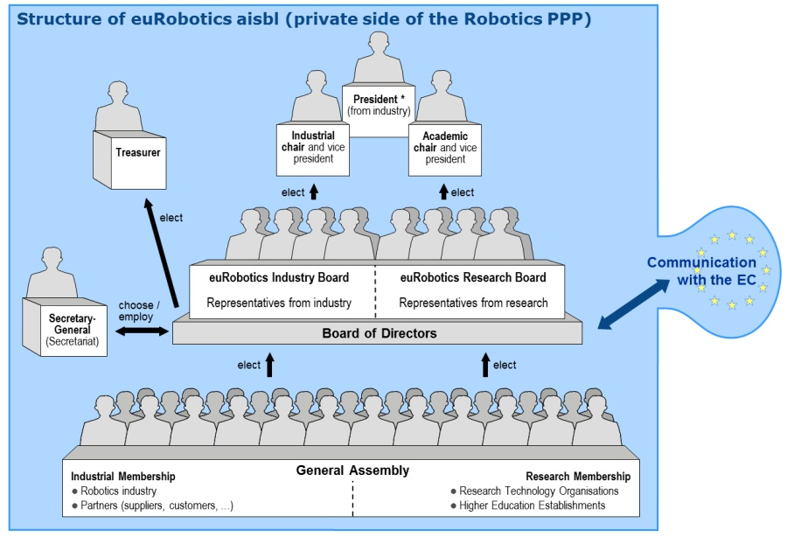
euRobotics
The new board of directors was elected on March 19th-21^{st,} 2013 at Lyon:
President: Bernd Liepert
Vice-Presidents: Rainer Bischoff (industry), Herman Bruyninckx (research) Treasurer: Giovanni Barontini

Slide 6
euRobotics Board of Directors (2 years)
Industry Board
Bischoff Rainer KUKA
Tomatis Nicola Bluebotics
Brodtmann Thilo EUnited Robotics
Pegman Geoff R U Robots
Barontini Giovanni Finmeccanica
Parlitz Christopher Schunk
von Wichert Georg Siemens
Champion Renaud Robolution Capital
Matthias Björn ABB
Gelin Rodolphe Aldebaran
Grothaus Hans‐Peter Claas
Research Board
Bruyninckx Herman KU Leuven
Siciliano Bruno University of Naples
Metta Giorgio IIT
Dario Paolo Scuola Sup. Sant'Anna
Albu‐Schäffer Alin DLR
Hallam John Univ. of S. Denmark
Agirre Ibarbia Jon Tecnalia
Asfur Tamim KIT
López de Vallejo Irene IK4 Tekniker Röning Juha Oulu University
Hägele Martin Fraunhofer IPA
Lane David Heriot Watt Univ.

Slide 7
euRobotics Activities 2012-2013
Supported and united EUROP & EURON
Foundation of euRobotics AISBL
MoU with EC regarding Public-Private Partnership (PPP)
New SRA for PPP initiated
Collaborations established with traditional and non-traditional stakeholders, e.g., RoboCom, ManuFuture, EFFRA, euCog, agriculture, …
European Robotics Forum established (4th edition: Lyon, 19/03 – 21/03/2013)
European Robotics Week established (3rd edition planned for: 25/11 – 01/12/2013)
European projects @ AUTOMATICA 2012 showcased
Press Center online

Slide 8
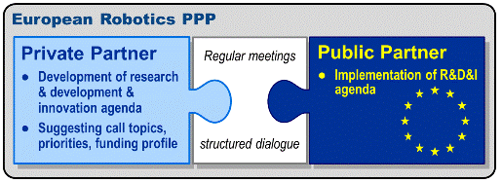
Robotics PPP
About Robotics PPP
The European Robotics Public Private Partnership (PPP) is the teaming up of the robotics industry, research, academia and the European Commission to launch a joint research, development and innovation programme in order to strengthen the position of European robotics as a whole. The programme will be jointly developed by the private side (robotics manufacturers, component manufacturers, systems integrators, end users, research institutes, universities) and the public side (the European Commission). Thus, the main objective of the Robotics PPP is to boost current European robotics research, development and innovation. It also aims to cultivate a positive perception of robotics in order to assure competitiveness and industrial leadership of manufacturers, providers and users of robotic technology based systems and services, as well as fostering the excellence of its science base.

Slide 9
Robotics PPP
Main issue:
Strategy Research Agenda (SRA) (http://www.eurobotics-project.eu/robotics-2020/downloads/downloads.html)
This agenda has been used for making the proposals for Call 1 and 2 in Horizon 2020 (first draft)
ICT Challenge 5 – Robotics
Call 1: Roadmap-based R&D&I in Robotics
RTD to advance key technologies relevant for industrial and service robotics (100% budget; 57M€)
Technology transfer - Robotics use cases (70% budget: 12M€)
Pre-commercial procurement in robotics (70% budegt; 5M€)
Shared resources and assessment (shared with RTD)
Call 2: Roadmap-based R&D&I in Robotics
RTD to advance key technologies relevant for industrial and service robotics (100%, budget: 39M€)
Technology transfer - Industry-academia cross-fertilisation (70%, budget: 13M€)
Technology transfer - Robotics use cases (70%, budget: 13M€)
Pre-commercial procurement in robotics (70%, budget: 5M€)
Community building and Robotic competitions (100%, budget: 4M€)

Slide 10
Robotics PPP Newsletter I
1. Application for a contractual PPP in robotics submitted: On Thursday, 13 June 2013, Vice-President Neelie Kroes of the European Commission received from our President, Dr Bern Liepert, the formal application of for a “contractual Public-Private-Partnership in robotics”. The evaluation will be done this year.
2. Negotiation phase of the Coordination Action “RockEU” close to finished: The Coordination Action “RockEU” (Robotics Coordination Action for Europe) is another stepping stone for the preparation of the PPP in robotics. It aims at providing the methodologies and prerequisites for establishing the Strategic Research Agenda 2020 on robotics, the multi-annual roadmaps, and the networking activities of euRobotics AISBL.
3. Call for the establishment of Topic Groups: Closely related to the progress in getting a contractual PPP established with the Commission is the creation of Topic Groups. All members of euRobotics AISBL are invited, if not encouraged, to organise and work in Topic Groups. Please refer to the attached call for objectives, criteria, and deadlines. Deadline for the “seeding phase” is 1 October 2013.

Slide 11
Robotics PPP Newsletter II
4. Call for organising the European Robotics Forum ERF 2014: ERF has become the most important European networking event in the field of robotics, bringing together people from different industries and all directions of research which can be found in Europe. The Board of Directors is soliciting suggestions from members of euRobotics AISBL for the location and organisation of the ERF 2014 which should take place between March and April 2014. Please find the criteria and the time table in the second attachment to this email. Deadline for submission is 15 September 2013.
5. Membership is growing: Our membership is steadily growing, having reached 117 by now, with further ones on the way to us, as we were told. Membership consists of 43 industrial organisations, 72 research organisations, and 2 regional robotics networks as associate members. In order to keep the balance somewhat right, I suggest that we all concentrate now on getting new members from industry – and end user organisations.
6. Vice-President Herman Bruyninckx at Digital Agenda Assembly Dublin
7. Next General Assembly: The next General Assembly should deal with the progress in getting the PPP in robotics established, the creation of the Topic Groups, cooperation with other PPPs and activities, results from some of the Task Forces, the selection of the location for the ERF, the acceptance of new members, and many other important issues. We are looking for a location which allows travel “to and fro” on one day, and assume a date in the first half of October 2013. We will inform you within the next two weeks.

Slide 12
Next Events
European Robotics Week 2013 will be from 25 November to 1 December 2013.
EFR (European Robotics Forum) October 2013

